Slide 1
Biological Warfare
A Review on
From historical past to present

Slide 2
Definition
Also known as Germ warfare
Biological warfare is a threat by using the biological agents like virus, bacteria, protozoa, fungus and other microorganisms, which cause disease to human, animals or plants by either releasing their toxins or by replicating within the host and finally cause to death.

Slide 3
Evolution in methods
In ancient time the bio-agents were delivered by hurling the affected cadaver, filth or their contagious materials to the unaffected population.
In modern time the bio-agents are isolated and grown in the laboratory and then have inoculated by special delivery mechanisms.

Slide 4
System of biological weapons
It is composed 4 components –
Payloads (the biological agents)
Munitions (containers keep the payload)
Delivery system (missiles, artillery shells, aircraft)
Dispersal mechanisms (an explosive force or spray device)

Slide 5
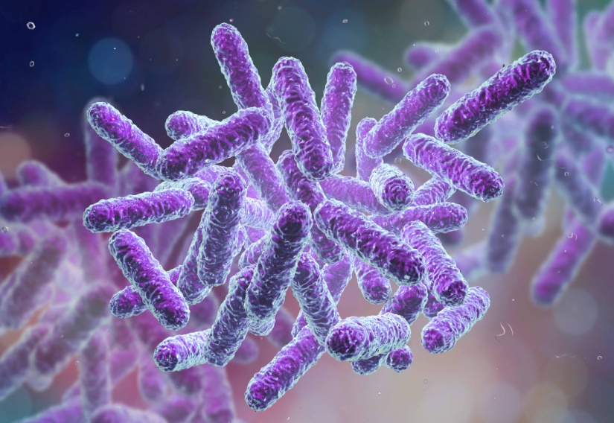
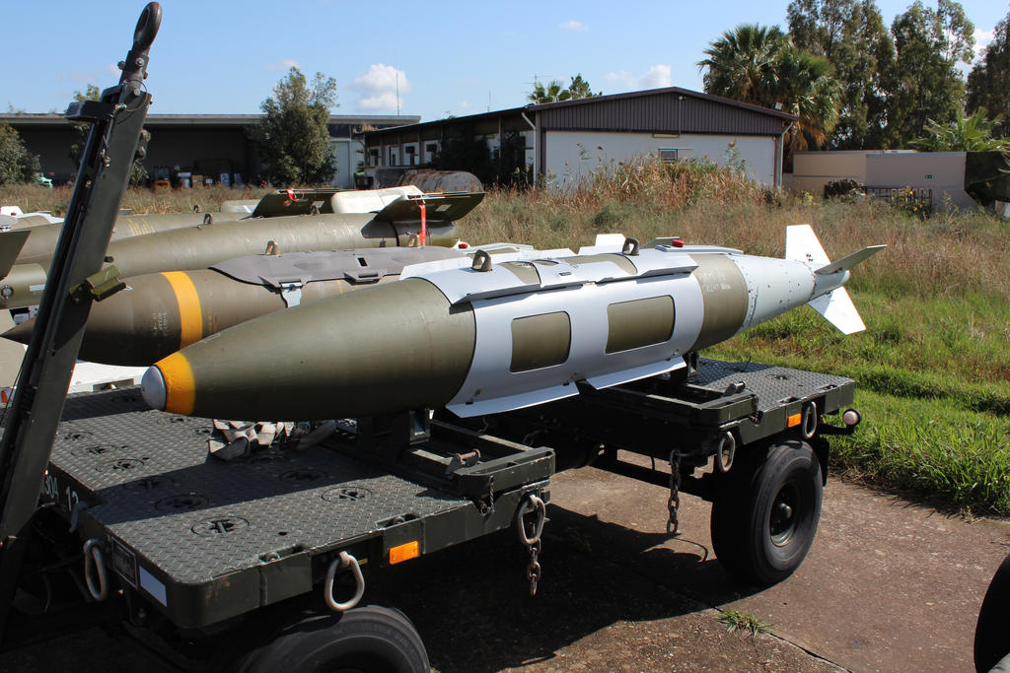
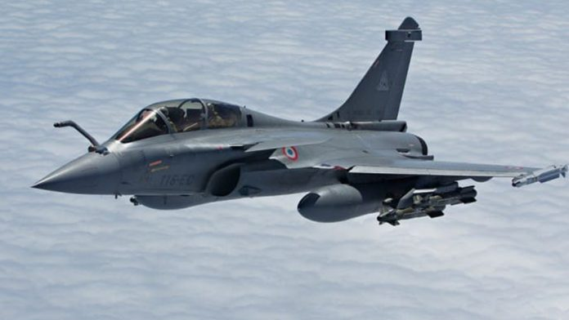
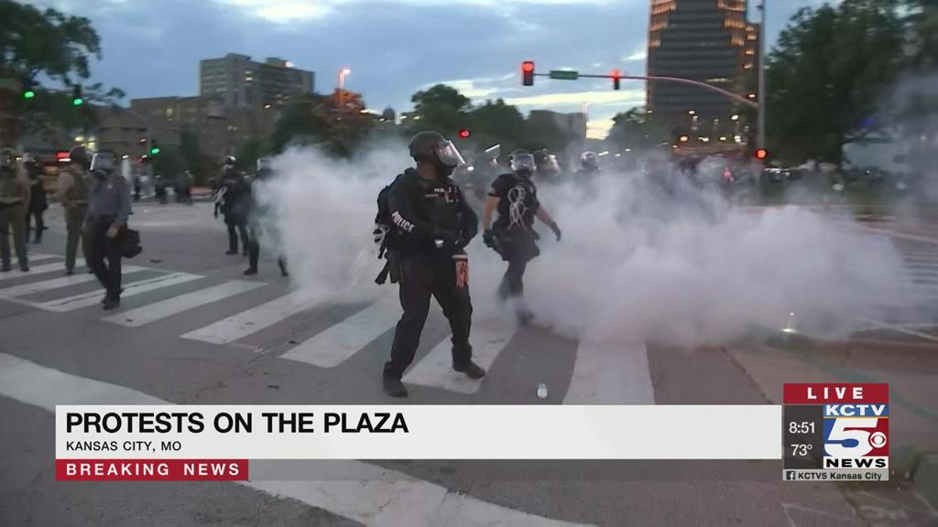
Payloads
Munitions
Aircraft
Sprayer

Slide 6
Before World War–I
1st one was the siege of Caffa
Tartar force spread corpse over the Ukraine city First plague epidemic in Europe
2nd one was during the French-Indian War
Sir Jeffrey Amherst provided infected blankets Epidemic of smallpox
During World War
Germany spread anthrax, glanders to many cattle of other country
League of Nation supported them
Japan construct “Unit 731”
10000 prisoners were died due to illegal experiments

Slide 7
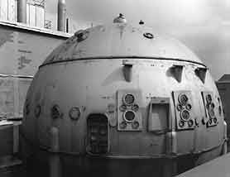
After World War – II
USA build up the “eight ball” in the Fort Detrick
New York, San Francisco released Serratia maecescens over their population
USA spread cholera to Hong Kong
In 1993, Japan was attacked with anthrax
Eight Ball

Slide 8
Attractive criteria of bio-agents for the terrorist
New morphology
Severely virulent
Difficult to diagnose
Not endemic in the target area
No availability of vaccines and drugs

Slide 9
Classifications of the agents
Category A : Highly transmissible and high mortality rate
Category B : Low mortality rate but diagnosis under development
Category C : Newly emerged disease and very little knowledge about these
Category A Anthrax Smallpox Botulism plague | Category B Glanders Q-fever Brucellosis Typhus fever | Category C Nipah virus Hantavirus Corona virus Yellow fever

Slide 10
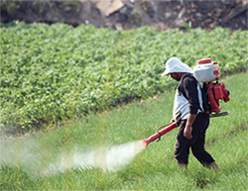
Mode of delivery
Mainly 2 mediums are accepted
Air medium
Food and water medium
Air mode delivery
Delivered in agro-field

Slide 11
Targets
Target of bio-attack
Biological
(target to cause disease)
Hard
(very large scale)
Soft
(small scale)
Economical/political
(target to destroy economy)

Slide 12
Impacts on physical and mental health
Ability to break down the total physical and mental health
Create depression and anxiety due to helplessness for family, friend, lover, neighbor
Autonomic arousal appears in many unaffected persons
Claustrophobia and breathing problems arise among the doctors and the nurses due to wear musk, gloves for a long time

Slide 13
Iraq: an example of brutality
Iraq used bacteria, virus, fungus and toxins in the “Operation Desert Storm”
Establishment of bioterrorism centers like Salman Park, Al Hakam Single cell Protein Production Plant, Al Manal, Muthana State Establishment etc
Use of – Clostridium perfringens, Aspergillus flavius, Ricinus communis, Fusarium oxysporium – as bio-weapons in normal war

Slide 14
Contd.
697000 US soldiers developed continuing health problems, having wide ranging symptoms, sum of signs of any morbid state Known as the Gulf War Syndrome
Gas gangrene, anthrax, food poisoning were the effects of this brutal bio-war

Slide 15
Conclusion
We can’t stop the heinous mentality of these bio terrorists by only some awareness programme without strong penalty. But we can take the following steps for our populations –
Increase availability of the medicines
Proper vaccinations programme
Take care of elderly persons, children, pregnant women

Slide 16
Reference
Eitzen EM Jr, Tarafuji ET. (1997). Historical Overview on Biological Warfare. Walter Reed Army Medical Center, 415-423
Riedel S. (2004). Biological Warfare and Bioterrorism: A Historical Review. Baylor University, Medical Center Proceeding; 17: 400-406
Wheelis M. (2002). Biological Warfare at the 1346 Seize of Caffa. Emerg Infect Dis; 8: 971-975
Christopher GW, Cieslak TJ, Pavlin JA, Eitzen EM. 919970. Biological Warfare: A Historical Perspective. JAMA; 278: 412-417
Hugh JM. (1992). Wichham Steed and German Biological Warfare Research. Intelligence and National Security; 7: 379-402
Stochholm International Peace Research Institute (SIPRI). The Problem of Chemical and Biological Warfare; Vol-1; The Rise of CB Weapons. New York; Humanities Press; (1971)
US Army Control and Disarmament Agency. Arms Control and Disarmament Agreements: Text and Histories of the Negotiations. Washington, DC; (1996)
Harris S. (1994). Factories of Death. New York; Routledge
Harries SH. (1992). Japanese Biological Warfare Research on Human: A Case Study on Microbiology and Ethics. Ann N Y Acad Sci; 666: 21-52
Radosavljevic V. (2018). Environmental Health and Bioterrorism. Elsevier; 2:450-457

Slide 17
Thank You

